Slide 1
Ethics
Dr Eilidh Cage

Slide 2
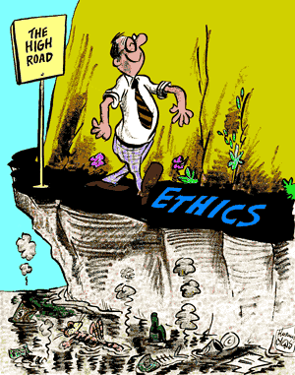
How do we define ethics?
In social science, we can think of it as “principles of conduct”

Slide 3
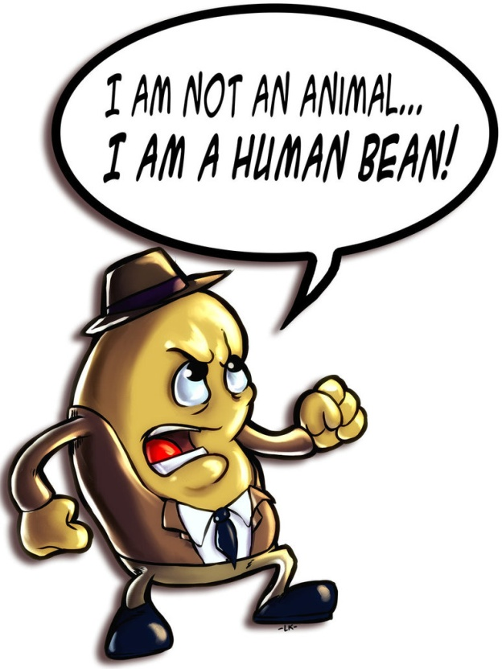
Why should we care about ethics?
Maintaining your/your organisations/social science’s reputation
Developing trust – so people take part in research in the future
Working with humans

Slide 4
BPS Ethical Principles
Respect for the autonomy and dignity of persons
Scientific value
Social responsibility
Maximising benefit and minimising harm
See the full BPS ethical guidelines here
Notes:
2.1 Respect for the autonomy and dignity of persons Value statement: ‘Psychologists value the dignity and worth of all persons equally, with sensitivity to the dynamics of perceived authority or influence over others and with particular regard to people’s rights including those of privacy and self-determination’ (Code of Ethics and Conduct, 2009, p.10).
-In the research context this means that there is a clear duty to participants. For example, psychologists respect the knowledge, insight, experience and expertise of participants and potential participants. They respect individual, cultural and role differences, including those involving age, sex, disability, education, ethnicity, gender, language, national origin, religion, sexual orientation, marital or family situation and socio-economic status. Given this level of respect psychologists are naturally willing to explain the nature of the research to which participants are being asked to contribute, and to avoid any unfair, prejudiced or discriminatory practice, for example in participant selection or in the content of the research itself.
Researchers will respect the privacy of individuals, and will ensure that individuals are not personally identifiable
In their research, as in all other professional dealings, psychologists will seek to ensure that people’s rights are respected and protected
2.2 Scientific value Value statement: Research should be designed, reviewed and conducted in a way that ensures its quality, integrity and contribution to the development of knowledge and understanding. Research that is judged within a research community to be poorly designed or conducted wastes resources and devalues the contribution of the participants. At worst it can lead to misleading information being promulgated and can have the potential to cause harm.
Ethics standards: Psychologists are committed to ensuring that the scientific and scholarly standards of their research are accountable and of sufficiently high quality and robustness. Quality relates 10 The British Psychological Society primarily to the scientific design of the research and the consideration of potential risks of harm and protocols for addressing such difficulties (should they arise). It is important that the aims of the research are as transparent as possible to ensure that it is clear what the research intends to achieve.
2.3 Social responsibility Value statement: The discipline of psychology, both as a science and a profession, exists within the context of human society. Accordingly, a shared collective duty for the welfare of human and non-human beings, both within the societies in which psychology researchers live and work, and beyond them, must be acknowledged by those conducting the research.
-Psychological knowledge must be generated and used for beneficial purposes. Such purposes can be broadly defined as those that not only support and reflect respect for the dignity and Code of Human Research Ethics 11 integrity of persons (both individually and collectively) but also contribute to the ‘common good’.
2.4 Maximising benefit and minimising harm Value statement: In accordance with Ethics Principle 3: Responsibility of the Code of Ethics and Conduct, psychologists should consider all research from the standpoint of the research participants, with the aim of avoiding potential risks to psychological well-being, mental health, personal values, or dignity.
- Ethics standards: Psychology researchers should seek to maximise the benefits of their work at all stages, from inception through to dissemination.
- Normally, the risk of harm must be no greater than that encountered in ordinary life

Slide 5
Meeting ethical standards
How can we ensure our participants are treated with respect?
How can we ensure high scientific quality?
How can we ensure our research is for “good”?
How can we maximise benefits?
How can we minimise harm?

Slide 6
Informed consent
Participants must give explicit permission to take part in full knowledge of all of the risks and benefits
You should provide an information sheet and a consent form
See the ethics worksheet for example information and consent forms

Slide 7
Confidentiality
What can we do to ensure confidentiality?
Assign ID numbers to participants
Keep any identifying information separate
Store data securely e.g. password protected or locked filing cabinet
Collect data in a sensitive manner

Slide 8
Debriefing
After the research, you should give participants a debrief
Thank them for their time
Clarify what the study was about and how their data will be used
Give opportunity for further questions

Slide 9
Now it’s your turn...
Worksheet: Ethics
Feedback on form provided (e.g. swap with another group or teacher can provide feedback)

